Slide 1
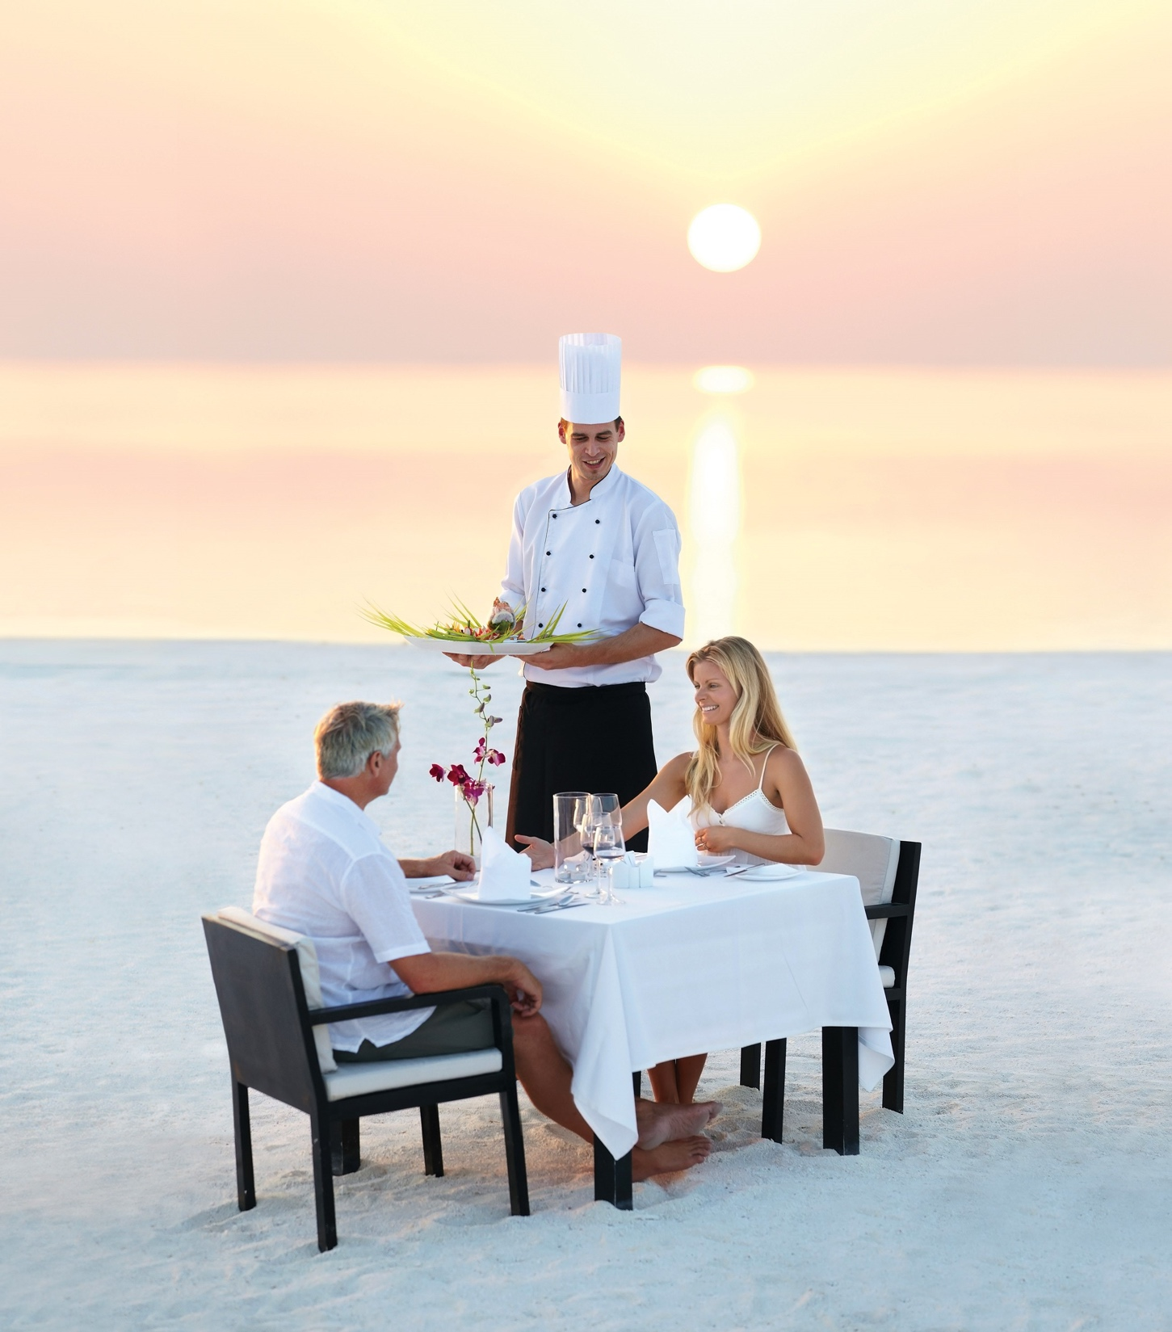

Chapter 4
Developing and maintaining a
service culture
© Hudson & Hudson. Customer Service for Hospitality & Tourism

Slide 2

Topics covered
  A definition of internal marketing
  The four-step internal marketing process
  Establishing and maintaining a service culture
  Developing a marketing approach to human resource management
  The importance of disseminating marketing information to employees
  The way to implement a reward and recognition system

Slide 3
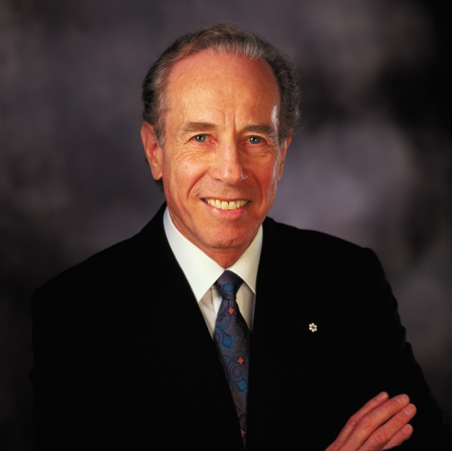
‘At Your Service’ Spotlight:
Four Seasons Hotels and Resorts
The Golden Rule
Focus on managing mid-sized luxury hotels
Service more important than fixtures and fittings
  Value-added extras
External quality control audits
  300 operating standards
Strong internal service culture
  Staff recruitment, perks, awards and internal promotion
Customer base
Repeat guests, willing to pay, recommend to friends
Recognition and Awards
Five Diamond Award, Fortune’s Hall of Fame,
Great Place to Work® Award, Robb Report ‘most exclusive brands of all time’

Slide 4
Internal marketing
…marketing aimed internally at a company’s own employees
Enables employees to deliver brand promise and satisfy guests
Ensure consistently high service
Four-step process:
  Establish a service culture
  Develop a marketing approach to human resource management
  Disseminate marketing information
  Implement reward and recognition system
Too few organizations apply the concept
Corporate distraction (boost revenues, cut costs)
But growing awareness that internal marketing will lead to profits

Slide 5
Link between internal marketing and profits
Figure 4.1

Slide 6
Establishment of a service culture
Organizational culture
  Formal and informal guidelines, actually activities
  Shared values and beliefs, behavioral norms
  Individuals understanding of organizational functions
Marketing culture
  Unwritten policies and guidelines and behavioral norms
  Defines importance of marketing, manner of execution
  Particularly important for service organizations
  Strong link between type of marketing culture and profits

Slide 7
Service culture
….a culture that supports customer service through policies,
procedures, reward systems, and actions
Culture must support customer service
Leaders crucial for transmitting, preserving culture
Commitment from management
  Positive attitude toward customers and employees
  Time and money transmitting value system
  Properly trained employees respond appropriately
  Empowered to do so by the organization
Establishing a service culture may have regional characteristics

Slide 8
The importance of empowerment
….the act of giving employees the authority to identify and solve guest problems or complaints on the spot, and to make improvements
in the work processes when necessary
Impacts customer perceptions of service quality
Essential aspect of internal marketing
Involves decentralized decision-making
  Demonstrated trust, respect for employees’ judgment
Gronroos’s interactive marketing concept
  Empowered front-line employees
  Control over task performance
Contingent on variability of customer needs, task complexity
Not suited to all employees

Slide 9
Empowerment and disempowerment: tourism and hospitality operations
Table 4.1 (Source: based on Lashley, 1995)

Slide 10
Marketing approach to human resource management
Involves the use of marketing techniques to attract and retain good employees
  Thinking creatively attracting qualified employees
  Understanding the employee market
  Building a positive company image
Assist with employee motivation, incentives, training
  Changing behaviors difficult, costly post-recruitment
    Right type of training can reduce ambiguity, and improve service delivery
Continuous training can improve morale and reduce turnover
  Hospitality industry turnover double that of other industries

Slide 11
Developing employee pride
Pride motivates people to excel
  More effective than money or position
Pride builders accomplish this by
  Setting aspirations that touch emotions
  Pursuing a meaningful purpose
  Cultivating personal relationships of respect
  Becoming a person of high character
  Injecting humor along the way

Slide 12

Snapshot:
WestJet : Fostering a caring culture
Canada’s Most Admired Corporate Culture
Airline loved by consumers, media and travel trade
Pride in product intrinsic to WestJet’s success
Internal service as important as external service
  Employee empowerment fundamental for spontaneity
  4 Kudos program
  CARE department – Create A Remarkable Experience
  Sense of ownership, profit sharing
Hire for attitude and train for skill
Consistently profitable

Slide 13
Dissemination of marketing information to employees
Frequency, quality, accuracy of communication
  Moderates ambiguity
  Increases job satisfaction
Communication mechanisms
  One-to-one
  Company meetings
  Training sessions
  Newsletters, emails, reports, videotapes
  Blogs (e.g. Southwest)
Notes:
S

Slide 14
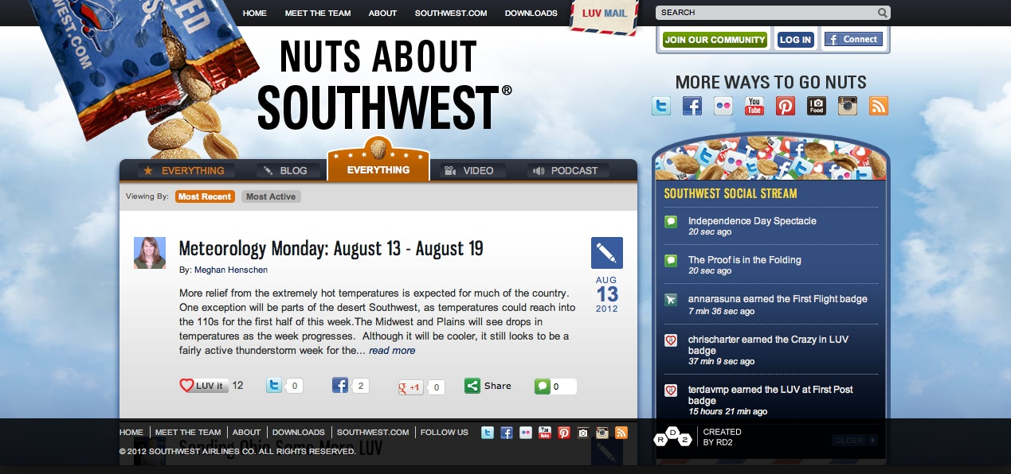
Southwest’s blog for customers and employees

Slide 15
Employee exclusion from the communication cycle
Many companies exclude customer-contact employees from communication cycle
Managers or supervisors fail to convey information
Frontline employees should be informed of
  Promotions and new products
  Changes in the service delivery processes
  Action steps in marketing plan
Poor internal communication a service quality risk
  Customer-contact employees not able to deliver advertising promises

Slide 16
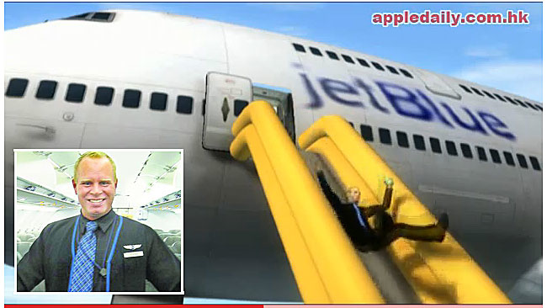
Implementation of reward and recognition systems
Employees should be made to feel happy and proud of their jobs
  Canadian survey - being made to feel valued important motivator
Organizations should
  Communicate performance objectives
  Provide relevant training
  Provide feedback
  Provide recognition (non-cash rewards)
  Tailor rewards to the interests of the employees
Employee dissatisfaction may lead to bad publicity

Slide 17
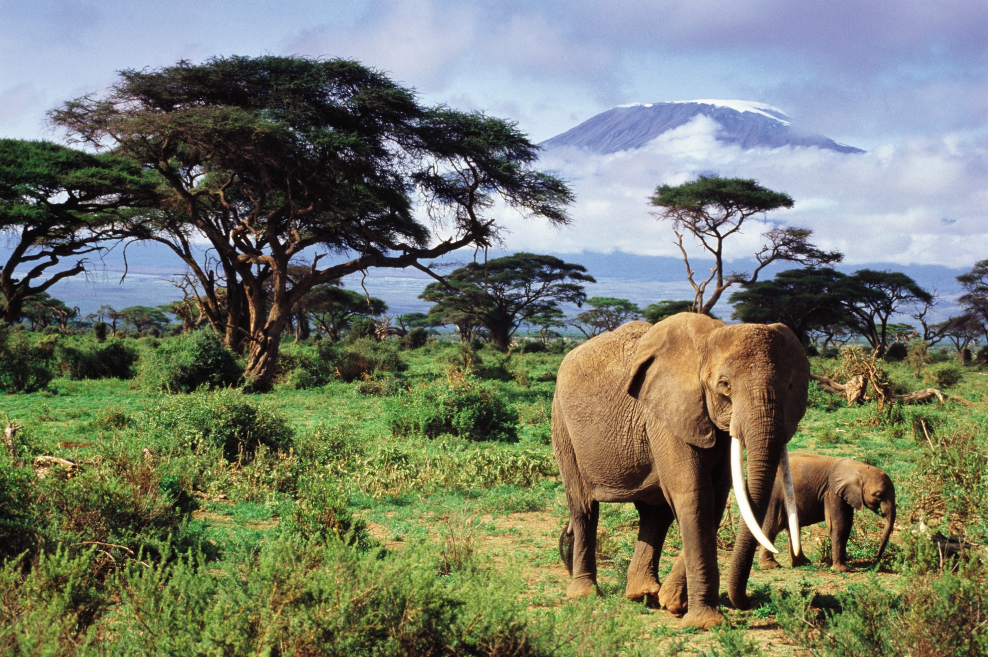
Case Study:
Micato Safaris – simply the best in the world!
Serving more than 5,000 clients a year, Micato programs deliver experiences and lodgings in destinations throughout East Africa, Southern Africa and India.
Micato has a well-deserved reputation for giving guests an experience that goes far deeper than any other tour, with access to sites rarely open to tourists, while supporting the local economy in myriad ways.
It is the family touch that drives Micato’s differentiation, but the company has also had to adapt more recently to new consumer demands.

